Slide 1
Al-Farabi Kazakh National University
Higher School of Medicine
Introduction to bio-organic chemistry

Slide 2
LEARNING OUTCOMES
As a result of the lesson you will be able to:
identify the general structural characteristics of organic molecules, in particular, the tetravalent nature of carbon and the different ways in which it can be expressed;
define functional group - identify the functional groups in organic molecules;
recognize structural (constitutional) isomers and functional group isomers;
write structures of organic molecules in various ways;
classify the organic compounds; name the compounds according to IUPAC system of nomenclature and also derive their structures from the given names;
draw structural, condensed, and line formulas for simple chemical compounds;
convert any given structural, condensed, or line formula into its corresponding alternative.

Slide 3
Literature
Organic Chemistry an intermediate text
Robert V. Hoffman
0-19-509618-5
1997
page 1-5, pages 25-27
Органическая химия том 1
В.Ф. Травень
5-94628-068-6
2006
главы с 1 по 8 и глава 12,
стр 33-43, 50-53, 133-141,
Органическая химия том 2
В.Ф. Травень
5-94628-068-6 5-95628-172-0
2006
весь 2 том полезные главы для медиков
Спирты. Стр 11-15. Эфиры. Стр 91- 94 Адьдегиды. Стр 116-124 Карб.кислоты. стр 206-212 Амины. 361-363 Углеводы. Стр 473-494
Organic Chemistry International Student version 10 edtion
T.W.Graham Solomons Craig B.Fryhle
978-0-470-52459-6
2011
p. 42 - 79, pages 137 -154,

Slide 4
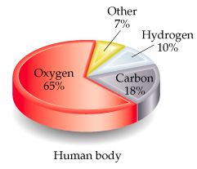
What are living things made of?
Guess how many elements your body is made up of?
  25 elements make up all living things
About 97% of your body’s mass is made of just 4 elements: oxygen, carbon, hydrogen, & nitrogen.
Two other major elements are phosphorous & sulfur.

Slide 5
Introduction
This set of lectures on bioorganic chemistry intend for non-chemistry students, mainly those entering health sciences and related fields, such as medicine, dentistry. It also can be useful for students in environmental studies.
Most students who take such courses consider bioorganic chemistry to be the most relevant part of the course of study. However, an understanding of bioorganic chemistry depends upon a sound background in organic chemistry. These lectures present organic chemistry in sufficient depth and breadth to make the bioorganic chemistry understandable.
The organic part of the set starts with basics of organic chemistry, such as classification of organic compounds, representation of organic molecules, nomenclature and hybridization, then moves to all classes of organic compounds, covering their physical and chemical properties, application and the most important examples. The bioorganic part allows students immediately apply the organic knowledge to carbohydrates and other biologically important compounds. This part ends with a chapter on DNA and RNA and a discussion of the chemistry of life.

Slide 6
Development of Organic Chemistry as a Science
In the past …,
Chemistry
Organic compounds
Inorganic compounds
obtained from living organisms
obtained from
non-living sources

Slide 7
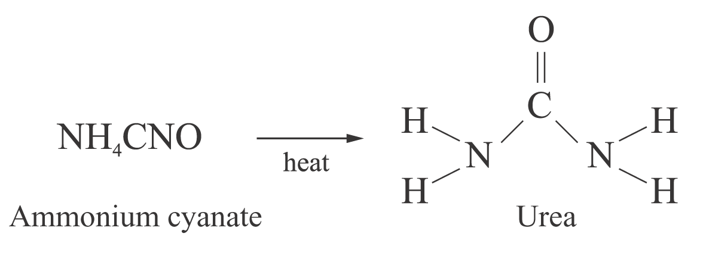
Development of Organic Chemistry as a Science
In 1828, Wohler (a German chemist)
(Inorganic compound)
(Organic compound)

Slide 8

Important Differences Between Organic and Inorganic Compounds
Bond type
  Organics have covalent bonds
    Electron sharing
  Inorganics usually have ionic bonds
    Electron transfer
Structure
  Organics
    Molecules
    Nonelectrolytes
  Inorganics
    Three-dimensional crystal structures
    Often water-soluble, dissociating into ions -electrolytes

Slide 9
Important Differences Between Organic and Inorganic Compounds
Melting Point & Boiling Point
  Organics have covalent bonds
    Intermolecular forces broken fairly easily
  Inorganics usually have ionic bonds
    Ionic bonds require more energy to break
Water Solubility
  Organics
    Nonpolar, water insoluble
  Inorganics
    Water-soluble, readily dissociate

Slide 10

Bioorganic chemistry is a chemistry which integrates organic chemistry and biochemistry.
Bioorganic chemistry involves the study of biological processes using chemical methods. Organic chemistry methods are used to synthesize biological
molecules and to examine their structure, to investigate biochemical reactions.
Organic chemistry is the study of the compounds of carbon.
The compounds of carbon are the central substances of which all living things on this planet are made.
Food clothes
Pharmaceuticals
DNA: the giant molecules that contain all genetic information for a given species. proteins: blood, muscle, and skin.
enzymes: catalyze the reactions that occur in our bodies. Compounds which furnish the energy that sustains life.

Slide 11
The most important element is…
Carbon
If you take away the water, the rest of the human body is 53% carbon.
It may not be the most abundant element in living things, but it certainly is the most important. At one time, scientists thought that the chemical reactions that took place inside of living things could not occur outside of them.
The carbon molecules were so complex, scientists thought they must have been made in some unknown way. They called these carbon compounds organic compounds

Slide 12
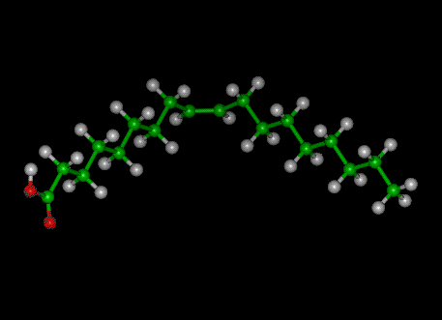
Why is life based on the element carbon?
There are two important properties of carbon that make it a suitable element to form the compounds in living things:
Firstly, carbon atoms can link together to form stable chains of great length.

Slide 13
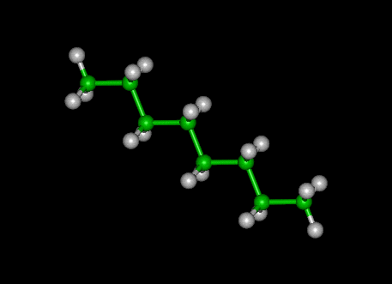
Why is life based on the element carbon?
Carbon atoms bind
strongly to each other
and form very large
molecules which are
built around this
carbon 'backbone'.
The covalent bond between two carbon atoms is strong so that the backbones are stable. In all of these compounds simple sub-units called monomers are linked together by condensation reactions.

Slide 14
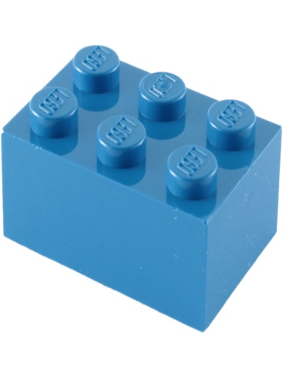
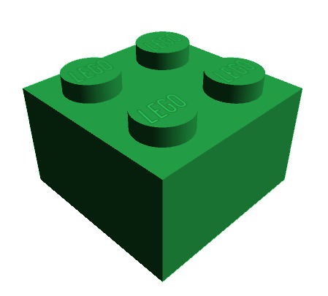
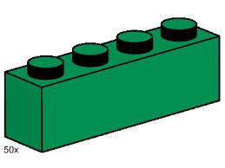
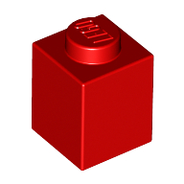
Organic chemistry is the chemistry of carbon compounds.
Carbon is tetravalent; it always form 4 bonds.
Nitrogen is trivalent; it often form 3 bonds
Hydrogen is monovalent; it always form 1 bond
That’s why organic compounds easy represent by lego bricks

Slide 15
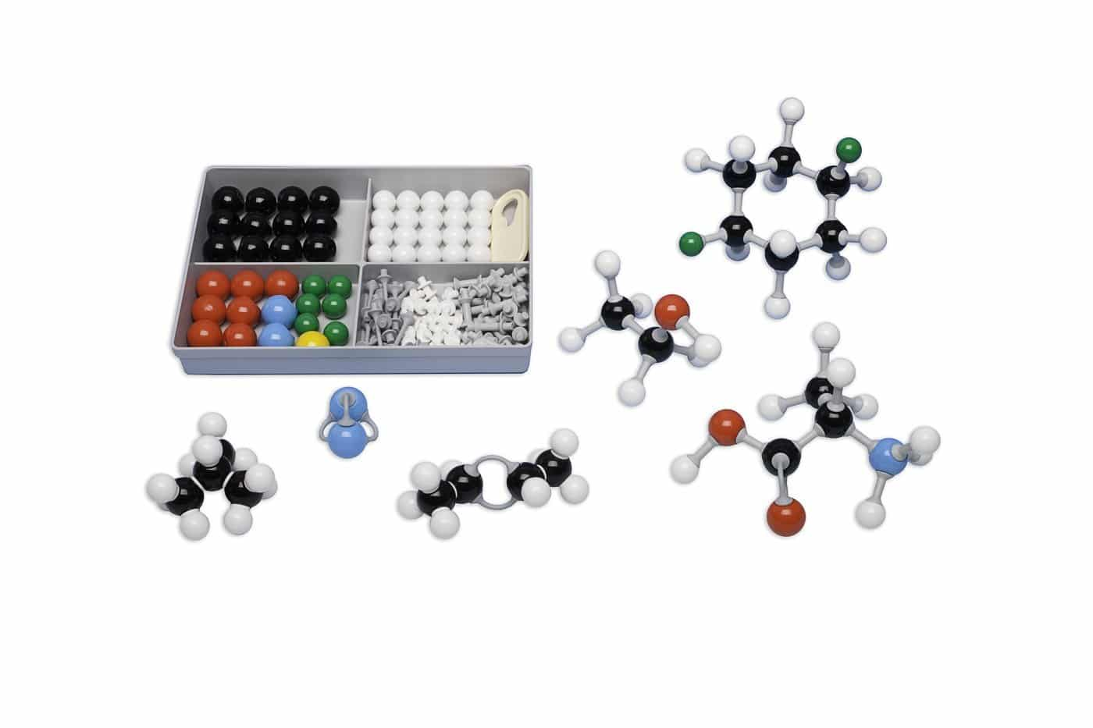
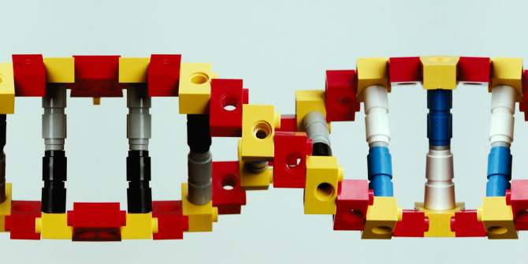
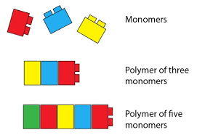
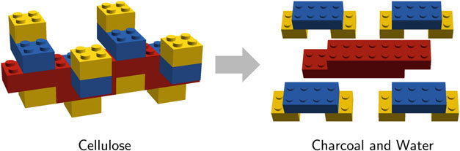

Slide 16
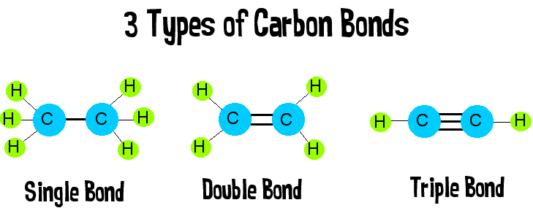
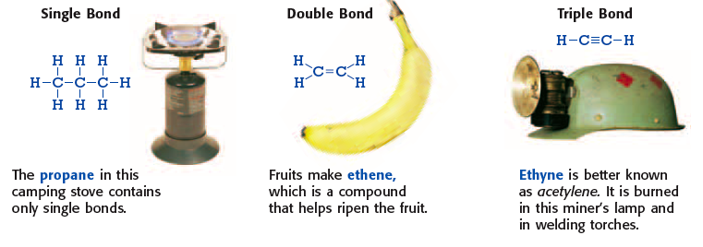

Slide 17
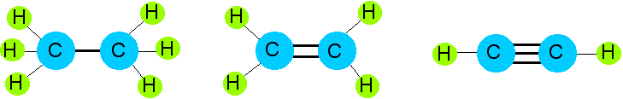
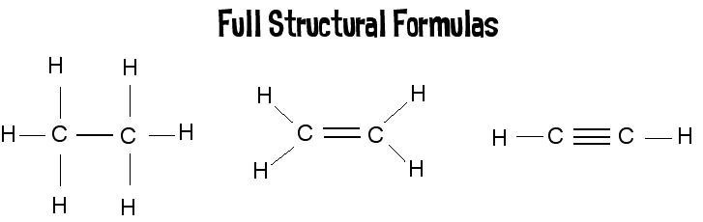
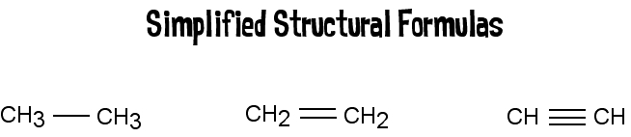
Lots of ways to draw this…

Slide 18
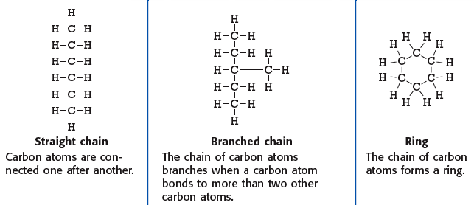
3 Types of Carbon Backbones

Slide 19
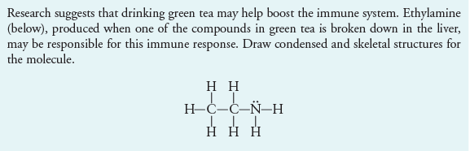

Slide 20
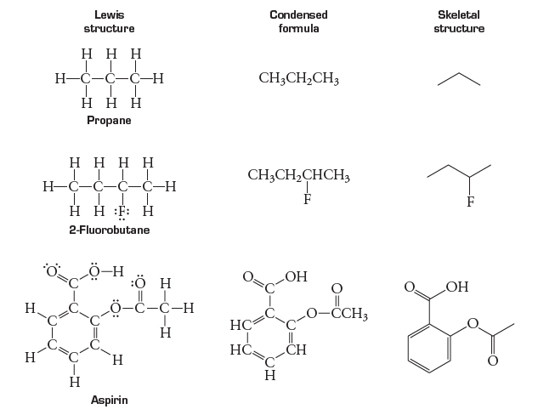

Slide 21
Families of Organic Molecules:
Functional Groups
A functional group is defined as an atom or a group of atoms that effectively determines the chemical properties of an organic compound.

Slide 22
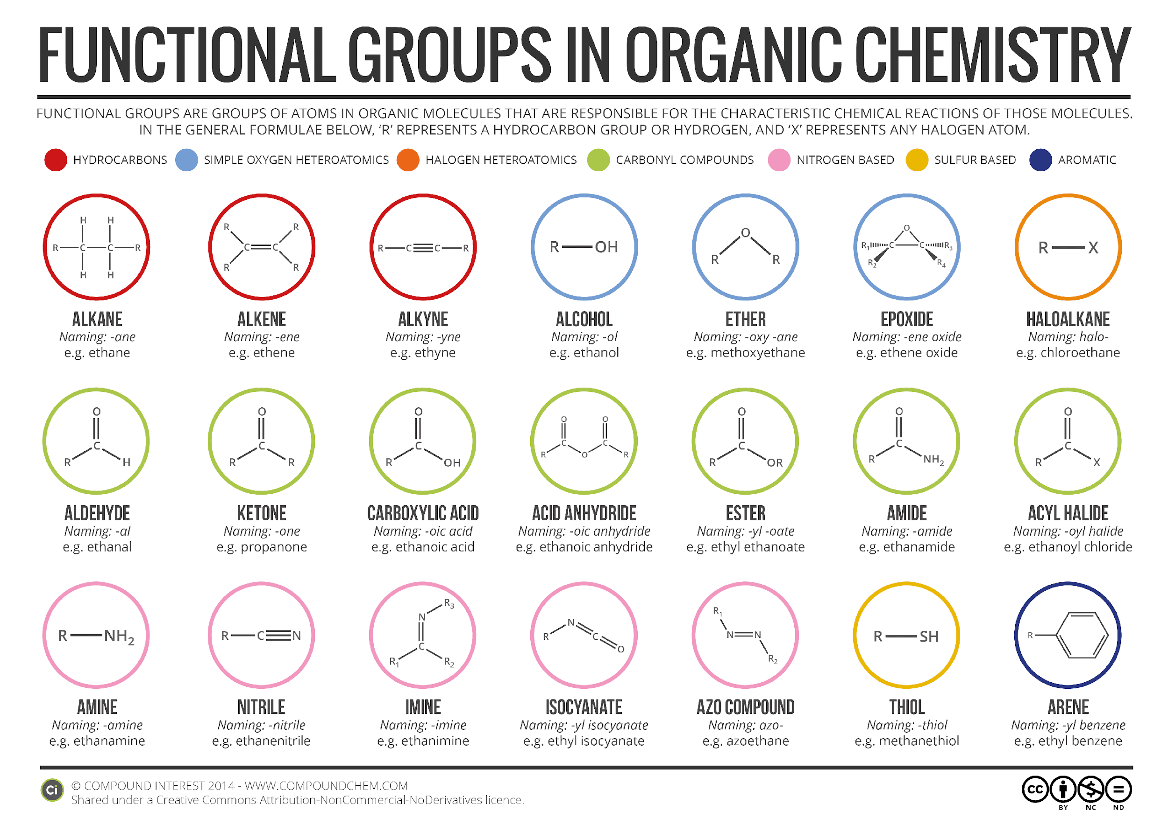
Functional Groups

Slide 23
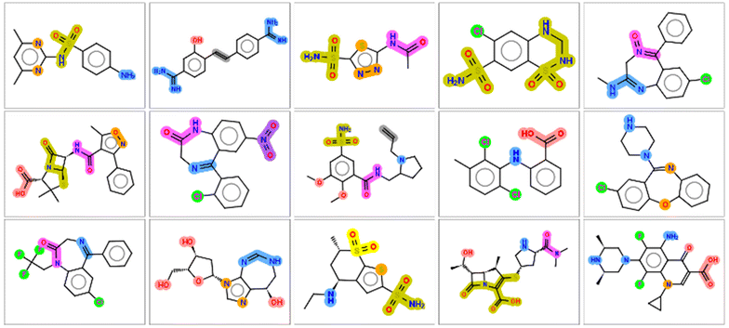
Case: identify and name the functional groups below

Slide 24
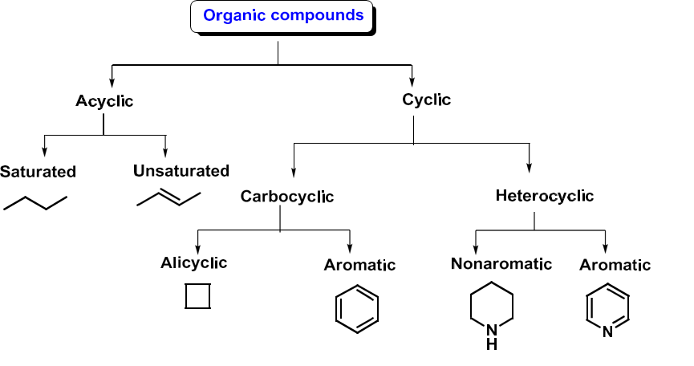
Classification of organic compounds
1. According to the character of chain of carbon atoms:

Slide 25
2. According to the functional group:
All organic compounds are grouped into classes based on characteristic features called functional groups.
A functional group is an atom or a group of atoms within a molecule that serves as a site of chemical reactivity.
The most important functional groups with the key structural elements and a simple example.
Functional group and its name | General structure and name | Example
-F, -Cl, -Br, -I (-Hal) Halogeno | R-Hal Halogenides | CH₃CH₂-Cl
-OH Hydroxy group | R-OH alcohols Ar-OH Phenols | CH₃-OH C₆H₅-OH
-OR Alkoxy group | R-O-R Ethers | C₂H₅-O-C₂H₅
-SH Mercapto group | R-SH Thiols | CH₃-SH

Slide 26
Functional group and its name | General structure and name | Example
-SR Alkylthio group | R-S-R Sulfides | CH₃-S-CH₃
-SO₃H Sulfo group | R-SO₃H Sulfonic acids | C₆H₅-SO₃H
-NH₂ Amino group | RNH₂, R₂NH, R₃N Amines | CH₃NH₂, (CH₃)₂NH, (CH₃)₃N
-NO₂ Nitro group | R-NO₂ Nitro compounds | CH₃CH₂-NO₂
Carbonyl group (oxo group) | Aldehydes Ketones | CH₃-CHO CH₃COCH₃
Carboxylic group | R-COOH Carboxylic Acids | CH₃-COOH

Slide 27
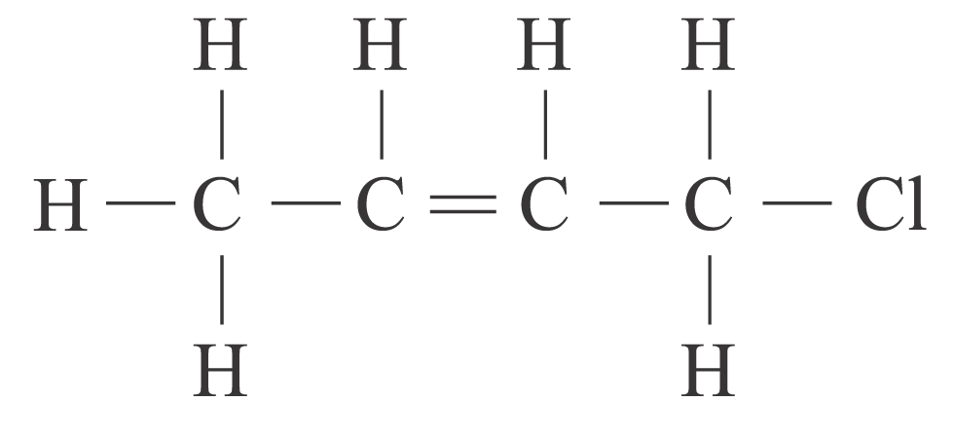
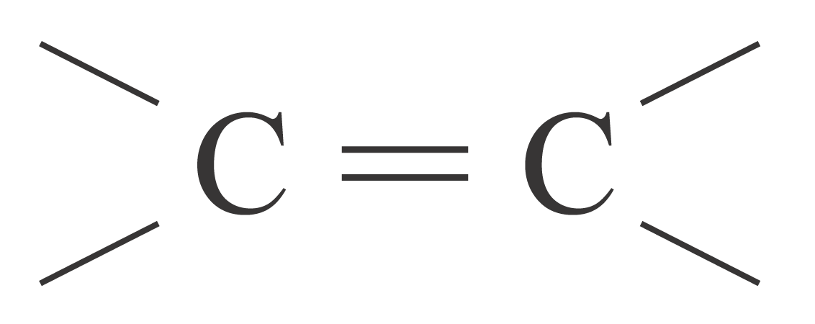
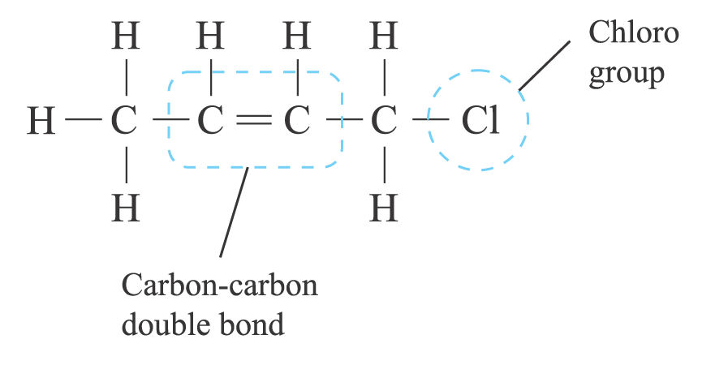
Example
Identify the functional group(s) in the following compounds:
(a)
Answer
Carbon-carbon double bond ( ) and chloro group (⎯Cl)

Slide 28
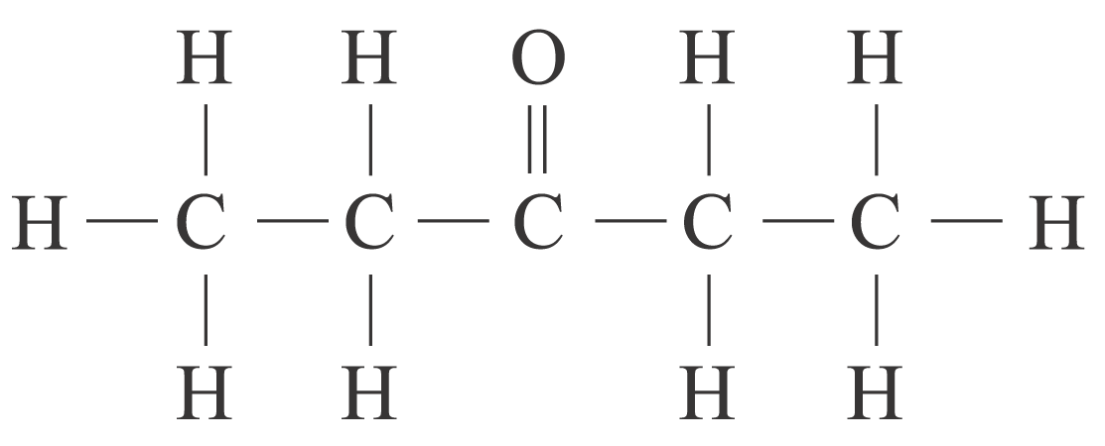
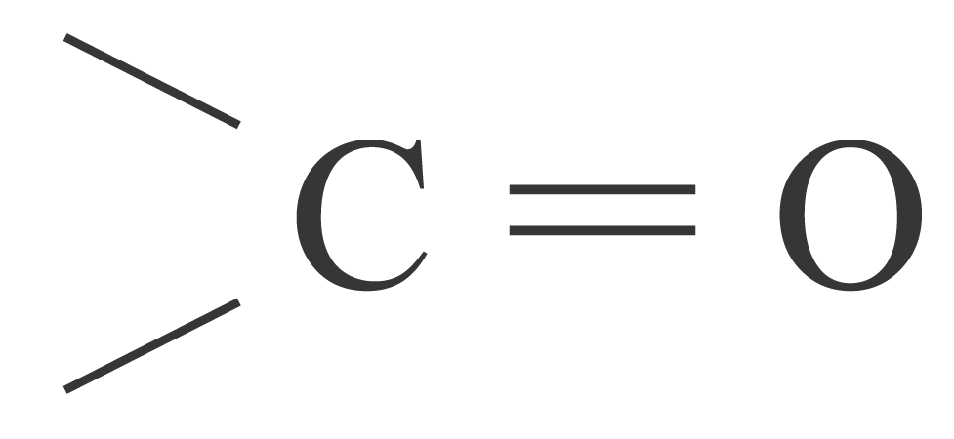
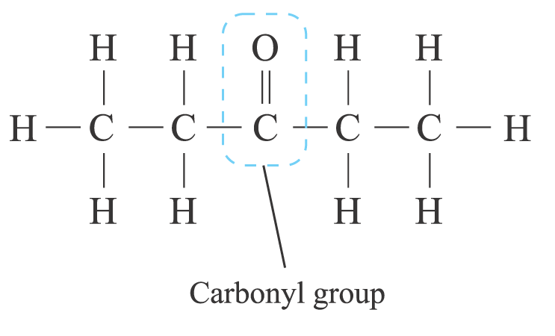
Example
Identify the functional group(s) in the following compounds:
(b)
Answer
(b) Carbonyl group ( )

Slide 29
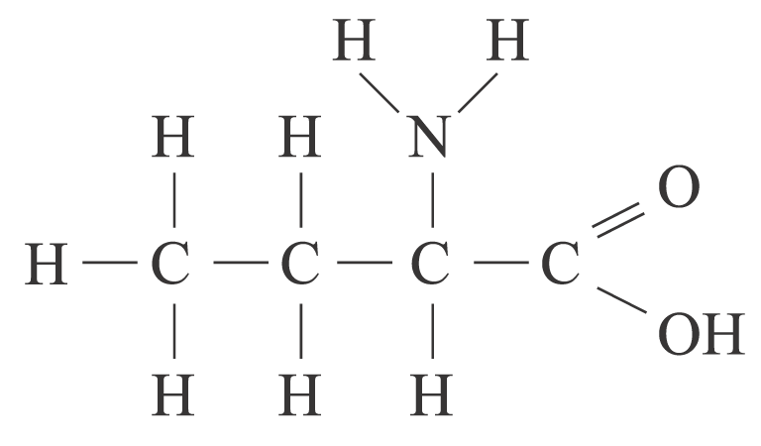
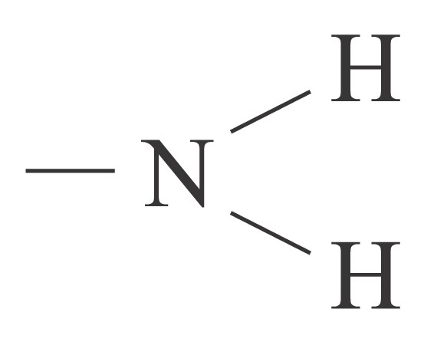
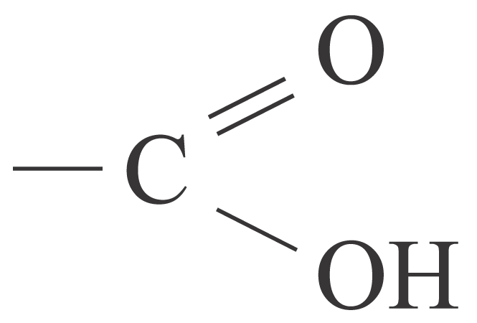
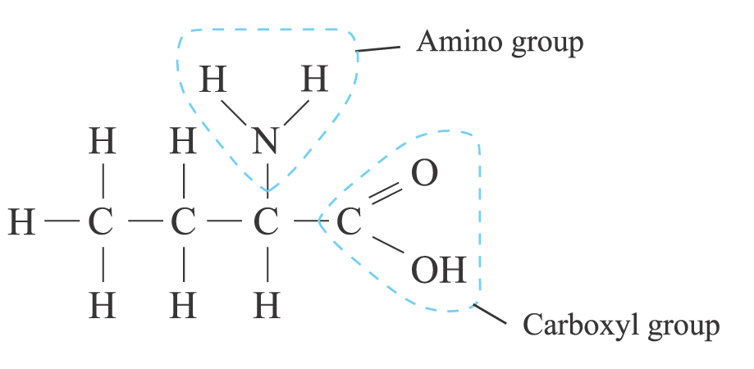
Example
Identify the functional group(s) in the following compounds:
(c)
Answer
(c) Amino group ( ) and carboxyl group ( )

Slide 30
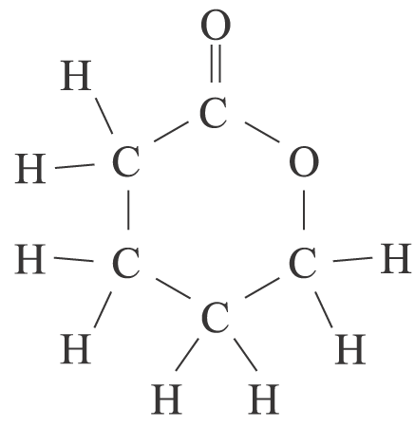
Example
To which homologous series does each of the following compounds belong?
(a)
(a) Ester
Answer

Slide 31
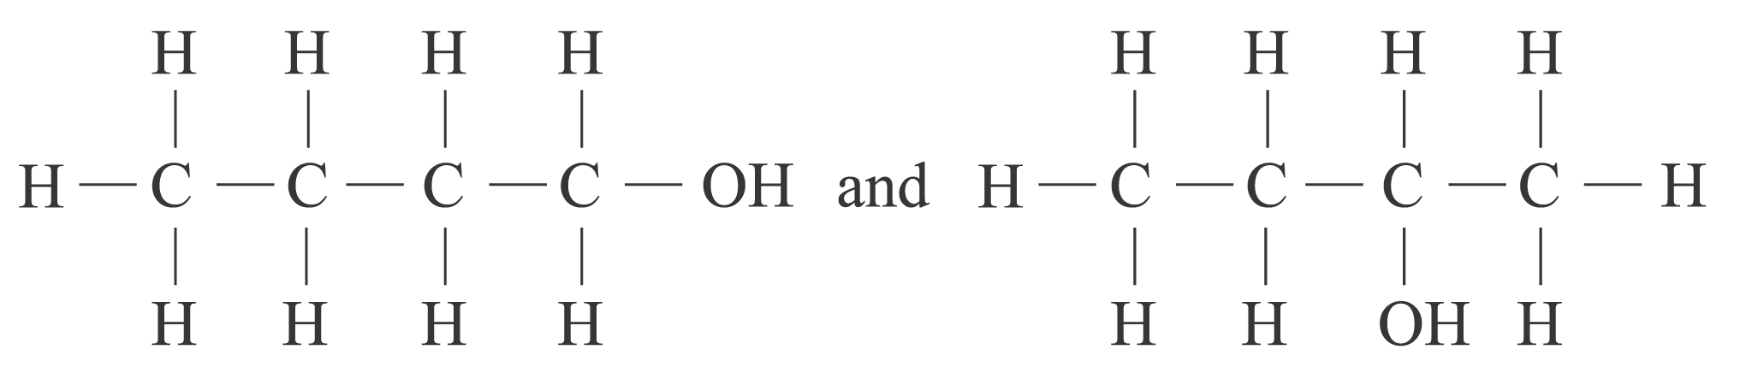
Example
State whether each of the following pairs of compounds belongs to the same homologous series. Explain your answer.
(b)
Answer
(b) Yes, both of them are alcohols.

Slide 32
Check Point
(a) Name the homologous series of organic compounds that contain oxygen atoms in their functional groups.
(a) Alcohol, ether, aldehyde, ketone, carboxylic acid, ester, acyl halide, amide and acid anhydride
Answer

Slide 33
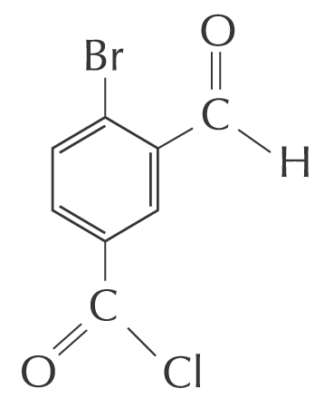
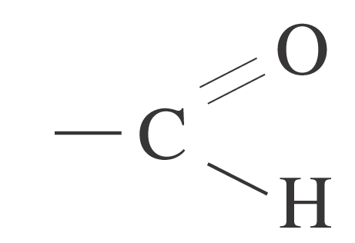
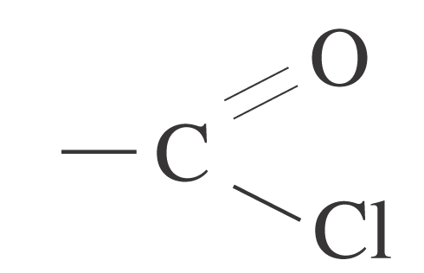
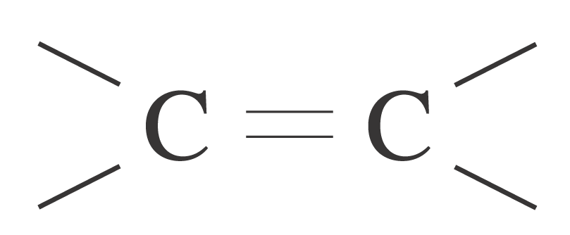
Check Point
(c) Identify and name the functional groups in the following compounds:
(c) ⎯Br (bromo),
(aldehyde),
(acyl chloride),
(carbon-carbon double bond) groups
Answer

Slide 34
Lots of carbon compounds seem to be isomers. What is an isomer?
In organic chemistry, there are many examples of different compounds which have the same molecular formula as each other,
But different arrangements (structures) of the atoms in their molecules.
These are called isomers.

Slide 35
If isomers have the same atoms in them, surely they have the same properties, so what's the point?
In fact, these small changes in structure can have significant effects on the properties of the substance!
But, it is important to realize that this can have significant effects in a living system.
One optical isomer of glucose, for example, can be used by a living cell, but the other isomer cannot.
This is because the enzyme in the cell which recognizes glucose is sensitive to only one form.

Slide 36
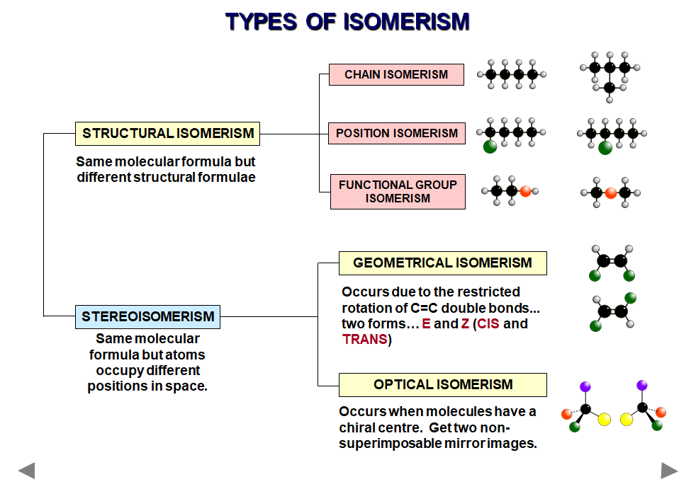

Slide 37
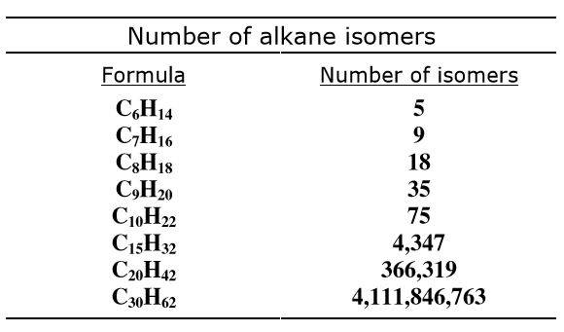
Isomerism

Slide 38
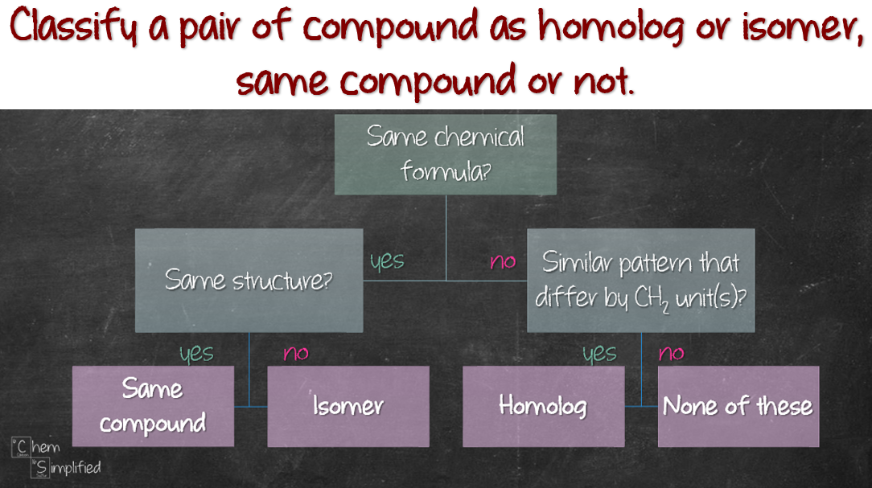
Notes:
http://www.chemsimplified.com/all-about-homolog-and-isomer/

Slide 39
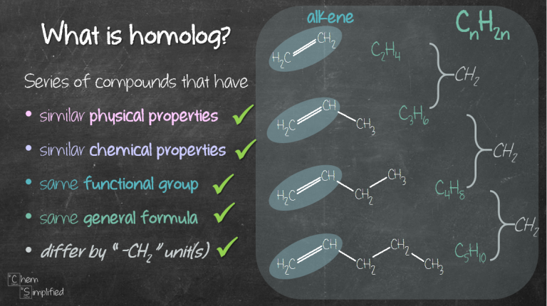

Slide 40
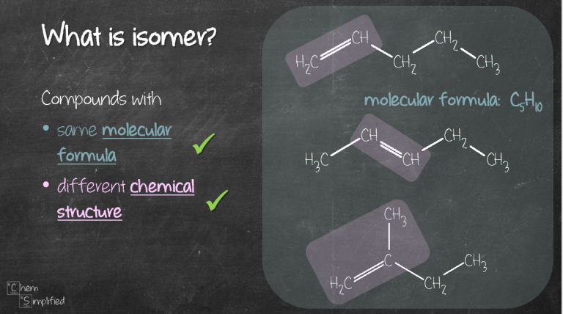

Slide 41
STRUCTURAL ISOMERISM - INTRODUCTION
COMPOUNDS HAVE THE SAME MOLECULAR FORMULA
BUT DIFFERENT STRUCTURAL FORMULA
Chain different arrangements of the carbon skeleton
similar chemical properties
slightly different physical properties
more branching = lower boiling point
Positional same carbon skeleton
same functional group
functional group is in a different position
similar chemical properties - slightly different physical properties
Functional Group different functional group
different chemical properties
different physical properties
• Sometimes more than one type of isomerism occurs in the same molecule.
The more carbon atoms there are, the greater the number of possible isomers

Slide 42
STEREOISOMERISM
Molecules have the SAME MOLECULAR FORMULA but the atoms are joined to each other in a DIFFERENT SPACIAL ARRANGEMENT - they occupy a different position in 3-dimensional space.
There are two types...
• GEOMETRICAL ISOMERISM
• OPTICAL ISOMERISM

Slide 43
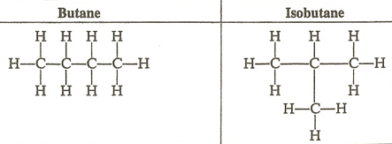
Chain Isomerism
Chain isomers of the same compound are very similar.
There may be small difference in physical properties such as melting or boiling point due to different strengths of intermolecular bonding.
Their chemistry is likely to be identical.

Slide 44
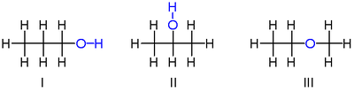
Positional Isomers
Positional isomers are also usually similar.
There are slight physical differences, but the chemical properties are usually very similar.
However, occasionally, positional isomers can have quite different properties

Slide 45
Positional Isomers
A simple example of isomerism is given by propanol:
it has the formula C₃H₈O (or C₃H₇OH) and two isomers propan-1-ol (n-propyl alcohol; I) and propan-2-ol (isopropyl alcohol; II)
Note that the position of the oxygen atom differs between the two: it is attached to an end carbon in the first isomer, and to the center carbon in the second.
The number of possible isomers increases rapidly as the number of atoms increases; for example the next largest alcohol, named butanol (C₄H₁₀O), has four different structural isomers.

Slide 46
Isomerism
Constitutional Isomers (Structural Isomers) are different compounds of the same formula. The different structures from the previous slide for the formula C₄H₁₀ is an example of Constitutional isomers.

Slide 47
Isomerism
Constitutional Isomers (Structural Isomers) are different compounds of the same formula. The different structures from the previous slide for the formula C₄H₁₀ is an example of Constitutional isomers.
How many isomers are there of an alkane containing five carbons (C₅H₁₂)?
Isomer Strategy – Draw Lewis possible different length chains of carbons atoms connected with a covalent bond.

Slide 48
Isomerism
Constitutional Isomers (Structural Isomers) are different compounds of the same formula. The different structures from the previous slide for the formula C₄H₁₀ is an example of Constitutional isomers.
How many isomers are there of an alkane containing five carbons (C₅H₁₂)?
Isomer Strategy – Draw Lewis possible different length chains of carbons atoms connected with a covalent bond.
Chains of 5 carbon atoms
H
H
H
H
H
C C C C C
H
H
H
H
H
H
H

Slide 49
Isomerism
Chains of 4 carbon atoms
H
H
H
H
H
C C C C
H
H
H
C
H
H
H
H

Slide 50
Isomerism
Chains of 4 carbon atoms
Chains of 3 carbon atoms
H
H
H
H
H
H
H
C
H
H
C
C
C
C
H
H
H
C
C
C
H
H
H
C
H
H
H
H
C
H
H
H
H
H

Slide 51
Isomerism
Chains of 4 carbon atoms
Chains of 3 carbon atoms
H
H
H
H
H
H
H
C
H
H
H
C C C C
H
H
C
C
C
H
H
H
C
H
H
H
H
C
H
H
H
H
H
There are three isomers of C₅H₁₂

Slide 52
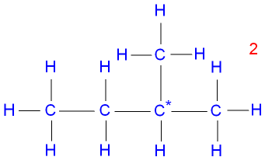

NOT ISOMER IF…
They have the same name
If can rotate/flip one to look like the other

Slide 53
? same

Slide 54
same ?

Slide 55
same?

Slide 56
same?

Slide 57
Types of carbon
1. Primary (1◦) Carbon connected to one carbon atoms.
2. Secondary (2◦) Carbon connected to two carbon atoms.
3. Tertiary (3◦) Carbon connected to three carbon atoms.
4. How many primary, secondary, and tertiary carbons in the
two different structures of C₄H₁₀

Slide 58
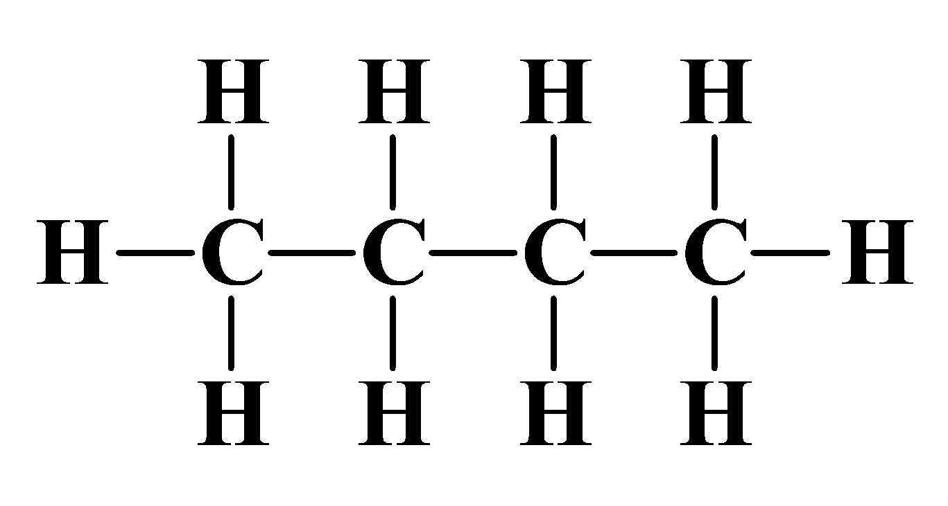
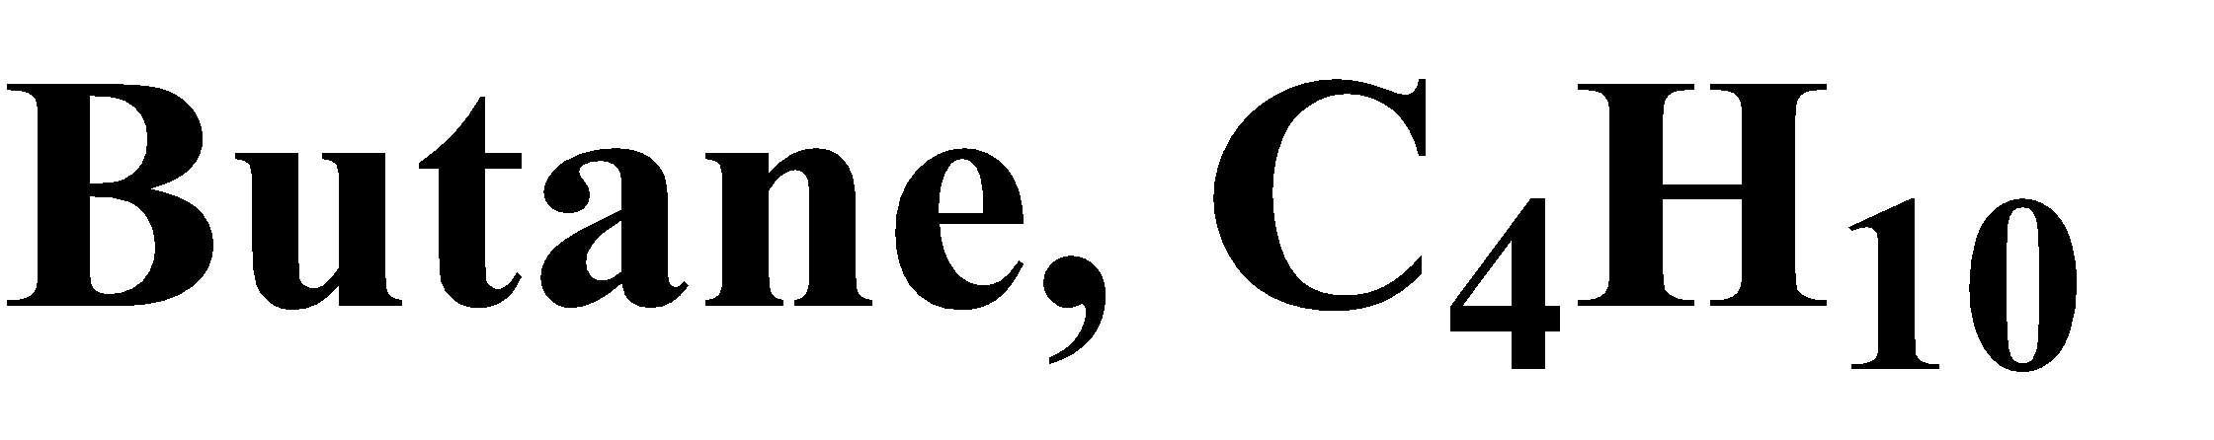
Types of carbon
1. Primary (1◦) Carbon connected to one carbon atoms.
2. Secondary (2◦) Carbon connected to two carbon atoms.
3. Tertiary (3◦) Carbon connected to three carbon atoms.
4. How many primary, secondary, and tertiary carbons in the
two different structures of C₄H₁₀
Primary carbon = ?
Secondary carbon =
Tertiary carbon =

Slide 59
Types of carbon
1. Primary (1◦) Carbon connected to one carbon atoms.
2. Secondary (2◦) Carbon connected to two carbon atoms.
3. Tertiary (3◦) Carbon connected to three carbon atoms.
4. How many primary, secondary, and tertiary carbons in the
two different structures of C₄H₁₀
Primary carbon = 2
Secondary carbon = ?
Tertiary carbon =

Slide 60
Types of carbon
1. Primary (1◦) Carbon connected to one carbon atoms.
2. Secondary (2◦) Carbon connected to two carbon atoms.
3. Tertiary (3◦) Carbon connected to three carbon atoms.
4. How many primary, secondary, and tertiary carbons in the
two different structures of C₄H₁₀
Primary carbon = 2
Secondary carbon = 2
Tertiary carbon =

Slide 61
Types of carbon
1. Primary (1◦) Carbon connected to one carbon atoms.
2. Secondary (2◦) Carbon connected to two carbon atoms.
3. Tertiary (3◦) Carbon connected to three carbon atoms.
4. How many primary, secondary, and tertiary carbons in the
two different structures of C₄H₁₀
Primary carbon = 2
Secondary carbon = 2
Tertiary carbon = ?

Slide 62
Types of carbon
1. Primary (1◦) Carbon connected to one carbon atoms.
2. Secondary (2◦) Carbon connected to two carbon atoms.
3. Tertiary (3◦) Carbon connected to three carbon atoms.
4. How many primary, secondary, and tertiary carbons in the
two different structures of C₄H₁₀
Primary carbon = 2
Secondary carbon = 2
Tertiary carbon = 0

Slide 63
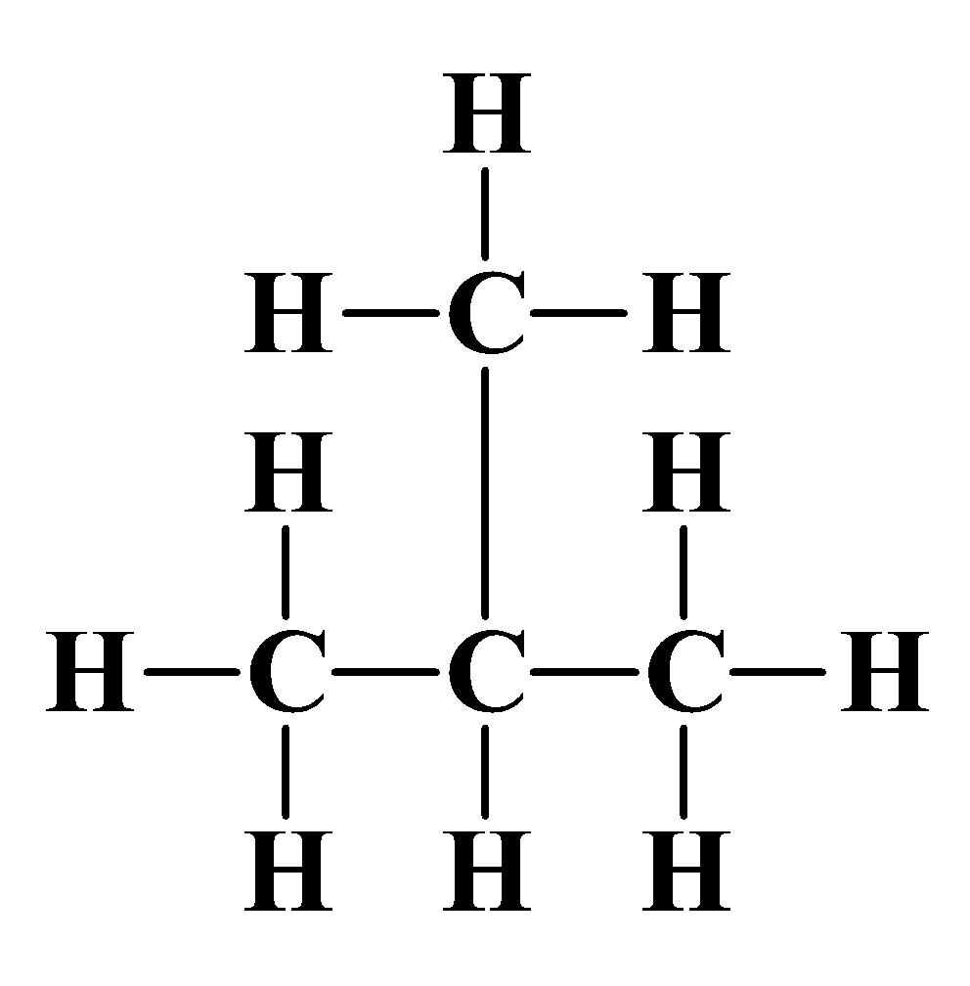
Types of carbon
1. Primary (1◦) Carbon connected to one carbon atoms.
2. Secondary (2◦) Carbon connected to two carbon atoms.
3. Tertiary (3◦) Carbon connected to three carbon atoms.
4. How many primary, secondary, and tertiary carbons in the
two different structures of C₄H₁₀
Isobutane C₄H₁₀
Primary carbon = ?
Secondary carbon =
Tertiary carbon =

Slide 64
Nomenclature of organic compounds
In the early days, organic compounds were named from their sources (common names), e.g.
Limonene (from lemons)
α-pinene (from pine trees)
Penicillin (from the mould penicillum notatum)
Advantages: Short names. Even today this method used to some extend, e.g. cubane (named after its shape).
Disadvantage: No obvious way of correlating common/ simple name with the structure of molecules.

Slide 65


Examples
Latin Hydrocarbon Roots
Number of Carbons | Latin Root
1 | meth
2 | eth
3 | prop
4 | but
5 | pent
6 | hex
7 | hept
8 | oct
9 | non
10 | dec
11 | undec
Latin Hydrocarbon Roots
Number of Carbons | Latin Root
12 | dodec
13 | tridec
14 | tetradec
15 | pentadec
16 | hexadec
17 | heptadec
18 | octadec
19 | nonadec
20 | eicos
21 | unicos
22 | doicos
H
n-butane
H
isobutane
H
H C H
H
H
H C C C H
H
H C H
H
H
neopentane

Slide 66
IUPAC
a logical systematic approach is needed. To achieve this aim an internationally recognized system of nomenclature devised by the International Union of Pure & Applied Chemistry (IUPAC) was used.
Advantages: Knowing the rules for naming, one can determine the correct structure.
Disadvantage: Can be cumbersome; e.g. IUPAC name for cubane pentacyclo[4.2.0.02,5.03,8.04,7]octane

Slide 67
Systematic System of Nomenclature (IUPAC)
Find the longest continuous chain of carbon atoms.
Use a Latin root corresponding to the number of carbons in the
longest chain of carbons.
Follow the root with the suffix of “ane” for alkanes
Carbon atoms not included in the chain are named as
substituents preceding the root name with Latin root followed
by “yl” suffix.
Number the carbons, starting closest to the first branch.
Name the substituent's attached to the chain, using the carbon
number as the locator in alphabetical order.
Use di-, tri-, etc., for multiples of same substituent.
If there are two possible chains with the same number of
carbons, use the chain with the most substituent's.

Slide 68
·A chemical name has three parts in the IUPAC system:
Prefix-Parent-Suffix
Where are the substituents? What family?
How many carbons?
Longest chain with the functional group of the highest priority (principal functional group)
-COOH, -SO₃H, -COOM, -COOR, -CONR₂, -CN, -CHO, -CO-, -OH, -SH, NH₂,
Decreasing priority of functional groups
NR₂, alkenes, alkynes.

Slide 69

NOMENCLATURE
Common system Examples
1. Give a name for the following compound
Step #1, count the number of carbons and write down the memorized Latin name
for that number (next slide)
Step #2, since this structure fits the alkane general formula, use the “ane” suffix
propane
Alkane suffix
Three carbon Latin root

Slide 70

Substituent Names (Alkyl groups)

Slide 71

Systematic Nomenclature continued.
Which one?

Slide 72
Systematic Nomenclature continued.
Which one?
The one with the most number of substituent's

Slide 73
Systematic Nomenclature continued.
Which one?
The one with the least number of substituent's
The top structure has four substituent's and the bottom has three
substituent's.

Slide 74
Systematic Nomenclature continued.
Which one?
The one with the least number of substituent's
The top structure has four substituent's and the bottom has three
substituent's.
Name = ?

Slide 75

Another Example:

Slide 76
Another Example:

Slide 77

Line Structures
A quicker way to write structures'
(Condensed Structure)
ethyl
methyl
(A line structure of the above condensed structure)
methyl

Slide 78

Complex Substituent's
If the branch has a branch, number the carbons from the point of
attachment.
Name the branch off the branch using a locator number.
Parentheses are used around the complex branch name.
3
1
1
2
1-methyl-3-(1,2-dimethylpropyl)cyclohexane

Slide 79

How about C₅H₁₂? The isomers are:
Pentane 2-methyl-butane 2,2-dimethyl propane

Slide 80

Nomenclature Practice
Name this compound
1
9 carbons = nonane
2
3
4
5
6
7
8
9
Step #1: For a branched hydrocarbon, the longest continuous chain of carbon atoms gives the root name for the hydrocarbon

Slide 81
Nomenclature Practice
Name this compound
1
9 carbons = nonane
2
3
4
5
6
CH₃ = methyl
7
8
chlorine = chloro
9
Step #2: When alkane groups appear as substituents, they are named by dropping the -ane and adding -yl.

Slide 82
Nomenclature Practice
Name this compound
1
9 carbons = nonane
2
3
4
5
6
CH₃ = methyl
7
8
chlorine = chloro
9
1
9
NOT
9
1
Step #3: The positions of substituent groups are specified by numbering the longest chain of carbon atoms sequentially, starting at the end closest to the branching.

Slide 83
Nomenclature Practice
Name this compound
1
9 carbons = nonane
2
3
4
5
6
CH₃ = methyl
7
8
chlorine = chloro
9
2-chloro-3,6-dimethylnonane
Step #4: The location and name of each substituent are followed by the root alkane name. The substituents are listed in alphabetical order (irrespective of any prefix), and the prefixes di-, tri-, etc. are used to indicate multiple identical substituents.

Slide 84

Naming Practice!!!
choose the correct ending
ene

Slide 85
determine the longest carbon chain with the double bond
ene

Slide 86
assign numbers to each carbon
ene

Slide 87

assign numbers to each carbon

Slide 88
ethyl
methyl
methyl
determine name for side chains
1-hexene
1-hexene

Slide 89




Slide 90


C
H
3
C
H
C
C
C
H
C
H
C
H
3
3
C
H
3

